Slide 1
Time Series Fundamentals
OLS Regression and Time Series Data
Or “Don’t go all Durbin Watson on me”

Slide 2
What the heck – let’s just run a regression on this time series data
Well, we’ve learned about two interesting time series processes – moving averages and autogression…but let’s go back to regression for a minute and see why time series analysis is useful…
It might be tempting to use regression on this time series data – remember we did this in the last slide deck to sniff for a single mean, although I warned you there was a problem. Why not just use our old friend multivariate regression on time series?
Because remember that one important assumption of regression is that of uncorrelated or independent error terms.

Slide 3
What the heck – let’s just run a regression on this time series data
What happens if the error terms are correlated?
The estimates of the regression coefficients are still unbiased – that’s good
The estimates of the standard errors of the coefficients are biased – that’s bad. In fact they are seriously biased downward.
So what does biased downward mean? It means that we are likely to reject a true null hypothesis – that is, we stand a serious risk of making a Type I error

Slide 4
What the heck – let’s just run a regression on this time series data
So how do we tell if the error terms are correlated – that is, not independent?
One way is to look at the residual plot of the errors from the regression model
What is a residual plot? Remember that a regression model produces predictions of each data point in the data set. A residual is simply the difference (e.g. error) between the actual data point and the prediction of that data point by the regression model
Residual = predicted data point - actual data point

Slide 5
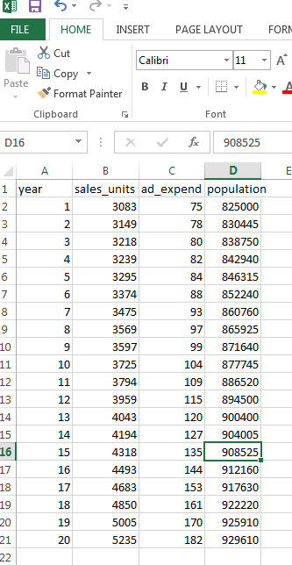
What the heck – let’s just run a regression on this time series data
Here is some sales data along with some ad expenditures in thousands of dollars and also population trends for our sales territory.
Note that it is time series data – that is the data is collected for each year of sales
Let’s run a regression of ad expenditures on sales using GRETL and see what’s there…

Slide 6
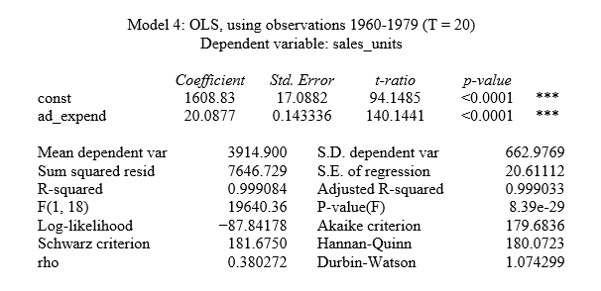
What the heck – let’s just run a regression on this time series data
Here is the regression from GRETL. Note the standard error for the ad expenditures is approximately .143 and that the relationship between ad expenditure and sales is significant p < .05

Slide 7
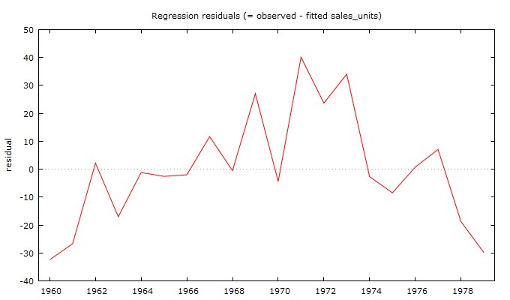
What the heck – let’s just run a regression on this time series data
If we plot the residuals – that is the errors from the model – against time, what do we see?
If the errors are uncorrelated we should see them “flip flop” back and forth across the zero line as time goes on? Is that the case?

Slide 8
What the heck – let’s just run a regression on this time series data
Looks like we may have correlated error terms and as a result of that, a deflated standard error for the regression coefficient – the fact that ad expenditures was statistically significant and related to sales could be a Type I error (oh no!)

Slide 9
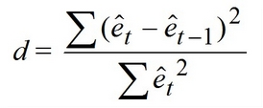
The Mysterious Durbin Watson Statistic
Is there some other way besides the Mark I eyeball test to tell if there is serial correlation in the residuals?
Yes there is – it is called the Durbin Watson test.
Differences between consecutive errors
Durbin Watson statistic
Error term for each prediction

Slide 10
The Mysterious Durbin Watson Statistic
Let’s look at the null and alternative hypotheses for the Durbin Watson test. The symbol ϕ stands for the serial correlation coefficient between errors (in this case consecutive errors). Remember correlation coefficients? If a correlation coefficient is zero then there is no correlation – that’s good for us in this case – the error terms are not correlated.
If the error terms are correlated – they are likely positively correlated and so that would be bad – resulting in underestimated standard errors for our regression coefficient for ad expenditures
H_{null}: ϕ = 0
H_{alt}: ϕ > 0

Slide 11

The Mysterious Durbin Watson Statistic
What is the Durbin Watson statistic look like for our regression?
According to the analysis, our Durbin Watson statistic = 1.074. Is that bad mojo? How do I tell?

Slide 12
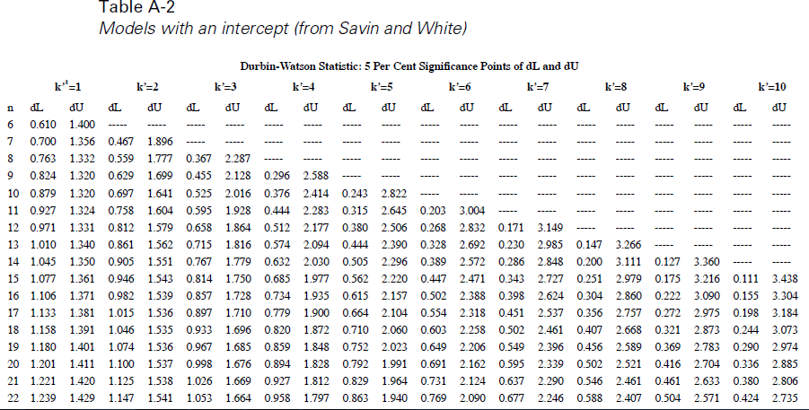
The Mysterious Durbin Watson Statistic
You have to use a Durbin Watson table like this one from Savin and White

Slide 13
The Mysterious Durbin Watson Statistic
The n along side the rows is the sample size. In our case we have 20 cases (20 years of data) so pick n=20.
k = number of IVs which in our case is one (ad expenditures)

Slide 14
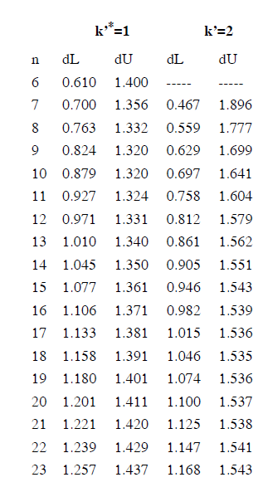
The Mysterious Durbin Watson Statistic
Let’s look closer at this. Notice that there is a column marked dL (Durbin lower limit) and another column marked dU (Durbin upper limit).
In this case dL = 1.201 and dU = 1.411

Slide 15
The Mysterious Durbin Watson Statistic
Here is the hypothesis testing rule for Durbin Watson
If d < dL then reject H_{null}: ϕ = 0
If d > dU do not reject H_{null}: ϕ = 0
If dL ≤ d ≤ dU then the test is inconclusive

Slide 16
The Mysterious Durbin Watson Statistic
Here is our regression analysis. Notice that our Durbin Watson from the regression is = 1.074
Remember from the chart that dL = 1.201 and dU = 1.411

Slide 17
The Mysterious Durbin Watson Statistic
If d from the data (d=1.074) is < dL then reject H_{null}: ϕ = 0
1.074 < 1.201 so reject H_{null}
d < dL

Slide 18
The Mysterious Durbin Watson Statistic
Oh, that’s bad – we have serially correlated error terms and so we violated a major regression assumption. Our significance test for the regression coefficient of ad expenditures is mess up – the standard error is wrong and too small. Should we just quit and go to Hills and Dales?
No we can fix this. One way to fix this is to include another important variable in the equation that we might have forgotten to include. That independent variable is time dependent.

Slide 19
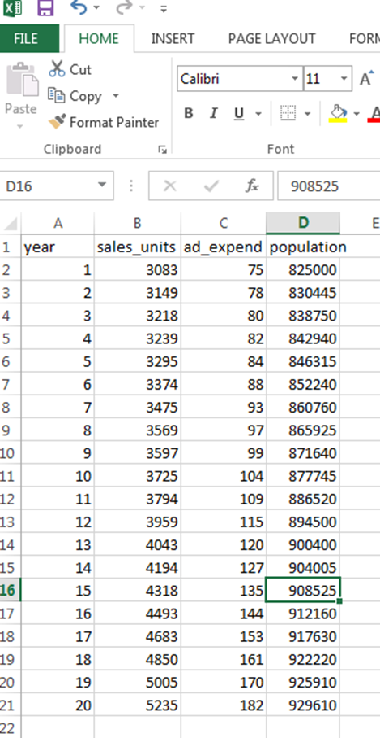
The Mysterious Durbin Watson Statistic
Let’s look at our data again…
We also have the variable that shows population in the sales region. That’s likely to be time dependent and also an important variable that is likely to influence sales. Let’s jam that variable into the model as well so our new model looks like:
Sales = α + b₁ ad_expend + b₂ pop

Slide 20
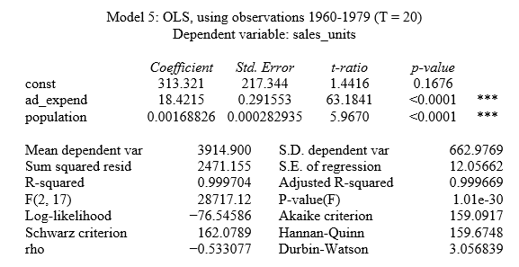

The Mysterious Durbin Watson Statistic
Here is our new regression analysis from GRETL. Let’s try our hypothesis test on the Durbin Watson again
If d > dU do not reject H_{null}: ϕ = 0 (remember k=2 now)
3.056 > 1.527 (with k=2) so cannot reject H_{null}
d > dU

Slide 21

The Mysterious Durbin Watson Statistic
So adding the variable population removed the serial correlation in our error term. So our standard error for the regression coefficient should not be biased downward.
That means the standard error for ad_expend here (.291) should be bigger than the original model (.1433) – is it? Yep…
Model with added time dependent variable
Original Model

Slide 22
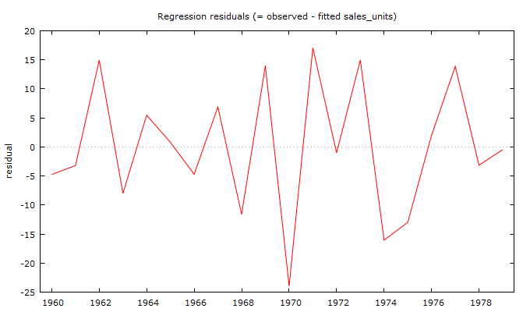
The Mysterious Durbin Watson Statistic
That also means that our residual chart for the new model with the time dependent variable of population should look a lot prettier and should “flip flop”– let’s see, does it?
Maybe the Durbin Watson statistic is not so mysterious after all!
Model with added time dependent variable
Original Model

